Slide 1
Big Data – Apache Spark
Lecture 7

Slide 2
Background
A typical Personal computer works well for watching movies or working with spreadsheet
However, your computer is not powerful enough to perform tasks like data processing on very large data set. Single machines do not have enough power & resources to perform computations on huge amounts of data
A cluster (group of machines) pools resources of many machines together allowing the use of all the cumulative resources
A group of machines alone is not adequate - need a framework to coordinate work across them eg Mapreduce or Spark
Spark manages and coordinates the execution of tasks on data across cluster of computers

Slide 3
Background
Hadoop MapReduce has been the de facto software development methodology for distributed computing and parallel processing for Big Data
Map Reduce is Batch processing
Batch processing is limiting and not the answer for every computational situation
Spark designed to be general purpose computational engine for interactive, batch, and streaming tasks that can leverage the same types of distributed processing resources that had powered MapReduce
Spark runs on commodity hardware and horizontally scalable (like MapReduce)

Slide 4
MapReduce is not for Iterative computation
Iterative computations that need to pass over the same data many times is not suited to Mapreduce as it does not cache data
MapReduce kills its processes as soon as a job is done
It is ideal when it comes to one pass ETL type jobs, for example, data transformation or data integration - this is what it was designed for

Slide 5
Apache Spark introduction
Spark can be thought of as Hadoop++ ; that is MapReduce done in better way
Spark exploit speed and scalability offered by in memory processing
MapReduce jobs continually write intermediate data back to disk throughout an often lengthy processing cycle and this degrades performance
A rule of thumb metric is that Spark delivers results on the same data set up to 100 times faster than MapReduce
Spark also promises to speed up application development by 10-100x making applications more portable and extensible

Slide 6
What is Apache Spark
Spark is an open source, distributed processing system used for big data workloads.
Utilises memory caching, optimized query execution for fast analytic queries against data of any size
Focused on interactive query, machine learning, and real time processing
Spark does not have its own storage system but runs on other storage systems like HDFS

Slide 7
Why Spark?
There was no general purpose computing engine in the industry:
To perform batch processing we use Hadoop MapReduce
For stream processing we were using Apache Storm
For interactive processing we were using Apache Tez
Apache Spark is open source engine and offers near real time stream processing, interactive processing as well as batch processing

Slide 8
Spark advantages over MapReduce
Spark offers 4 advantages for developing Big Data solutions:
Performance
Simplicity
Faster application development
Ease of administration

Slide 9
Use cases for Spark
Spark is particularly compelling in a few type of applications:
Streaming data
Artificial intelligence, machine learning, and deep learning
Business intelligence
Data integration

Slide 10
Streaming Data
Data that is continuously generated
Streaming data is produced by:
Sensors
Mobile devices
Financial transactions
Website access logs
Social media updates from: Facebook, Twitter, LinkedIn
Working directly on streaming data is different from the recent past IT systems, where enterprise driven transactions arrived at a much more leisurely rate and small volumes of data

Slide 11
Example of Spark Application in Financial Services
Spark application can analyse raw incoming credit card authorisations , completed transactions in near real time, rather than going through this information after the fact
This can be game changer for solutions like fraud prevention (rather than just detection)
For Example - could reject a bogus credit card transaction at point of sale in real time rather than allowing the fraudster to acquire merchandise and trigger a loss for bank and retail business

Slide 12
Artificial Intelligence and Machine Learning
Artificial intelligence (AI), machine learning (ML), and deep learning (DL) algorithms are being used to develop powerful new analytic capabilities across many areas
At the heart of any use case associated with AI, ML, and DL are sophisticated pattern recognition and classification capabilities
AI projects begin as Big Data problems, and the accuracy and quality of an AI model is directly affected by the quality and quantity of data used
It is predicted that emerging AI solutions will need eight to ten times the data volume used for current Big Data solutions. This data may come from many sources such from ERP systems, data lakes, sensors, mobile apps, social media, and legacy data. Data may be structured and unstructured

Slide 13
Spark and AI
In memory processing and highly efficient data pipelines make Spark a suitable analytics engine for data preparation, transformation, and manipulation for AI projects. Many steps are involved:
Identifying and connecting to data sources
Extracting the data
Tagging the data
Using tools and scripts to manipulate the data

Slide 14
Business Intelligence
For business to be more successful, users and BA need more up to data and full spectrum of an organisation data in a Big Data context
Traditional canned report are of limited value – ideally queries should be carried out right away. Need to provide users the flexibility to change their queries, drill down on the data, etc
Spark provides the required performance to allow on the fly analysis - not only by algorithms but also by people.
In a financial services investment scenario, this combination of computerised and human analysis of data and risk factors would result faster and more accurate trading decisions

Slide 15
Difference between Spark and MapReduce
Spark keep things in memory but MapReduce keeps shuffling things in and out of disk. MapReduce read/write is slow and slows down MapReduce
In SQL engines such as Hive, a chain of MapReduce operations is usually required and this requires a lot of I/O. On to disk, off disk - on to disk, off disk
Spark is magnitude faster than MapReduce. When similar operations are run on Spark, Spark can keep things in memory without I/O thus keep operating on the same data quickly. This improves performance
90% of time in MapReduce is doing IO
The benefit of MapReduce doing all that recording to disk is that recording everything to disk allows for the possibility of restarting after failure

Slide 16
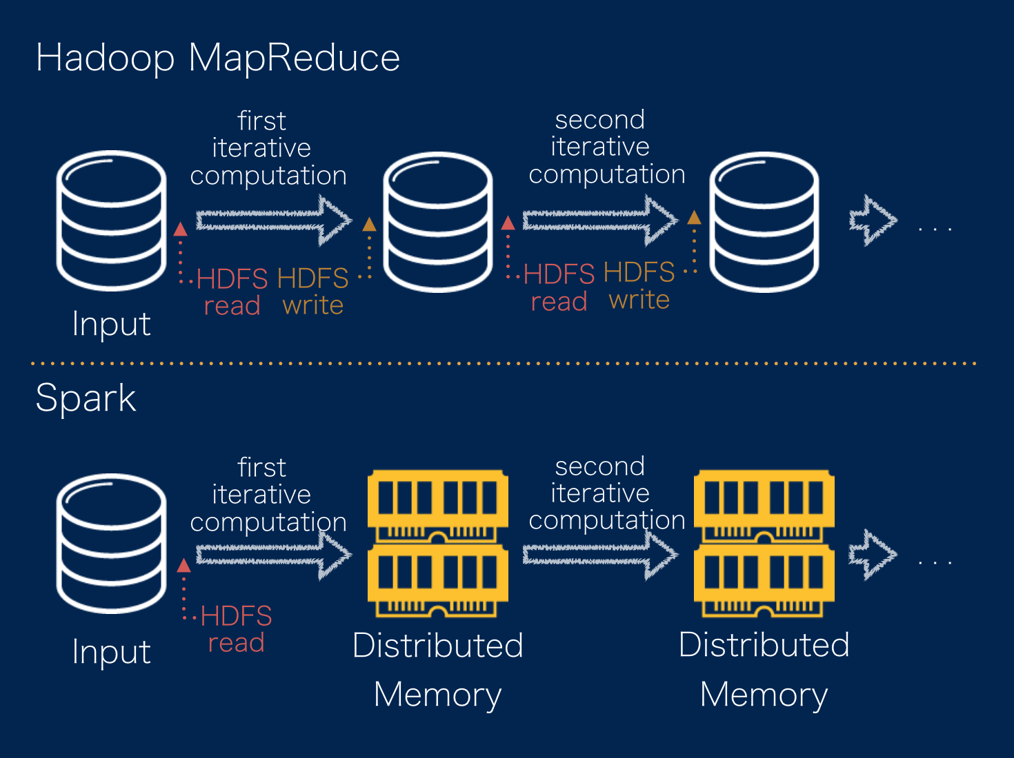

Slide 17
Difference between MapReduce and Spark
Faster development using Spark - Spark is more powerful and expressive in terms of how you give it instructions to process data
Spark provides instructions that are a higher level of abstraction than what MapReduce provides
Example - MapReduce wordcount program is over 100 lines of code vs Spark Word count is 4 lines of code
MapReduce-Wordcount.
Spark Examples
https://spark.apache.org/examples.html

Slide 18
Spark supports multiple data sources
MapReduce can process only the data present in distributed file system (HDFS)
Spark in addition to the distributed file systems such as HDFS, also provides support to using much popular databases via JDBC like MySQL, Postgress, Oracle

Slide 19
Class Questions
Why will Spark not be used commonly on an RDBMS?
It is often quoted that “Spark is 100 times faster than Hadoop” – what is a more accurate way to describe this?

Slide 20
Spark – Third Generation Distributed System
Exploit RAM as much as disk -> ‘in memory’ processing
Exploit multiple cores
Integrate HDFS for storage
Integrates with YARN (or Apache Mesos an alternative cluster management system)
Particularly suited to iterative and real time analysis
Can deliver order of magnitude performance improvements compared to Map Reduce for certain tasks

Slide 21
Spark - key points
Handles batch, interactive, and real-time within a single framework
Native integration with Scala, Java, Python
Scala is a functional programming language
is the least verbose of the three
Programming at a higher level of abstraction
More general: instead of just “map” and “reduce”, defines a large set of operations (transformations & actions)
Operations can be arbitrarily combined in any order
Open source software

Slide 22
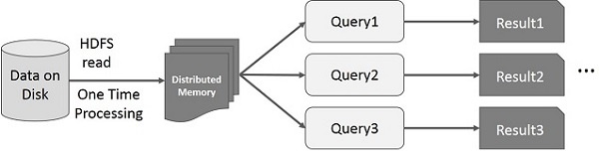
Spark RDD will eliminate Disk IO and read from memory

Slide 23
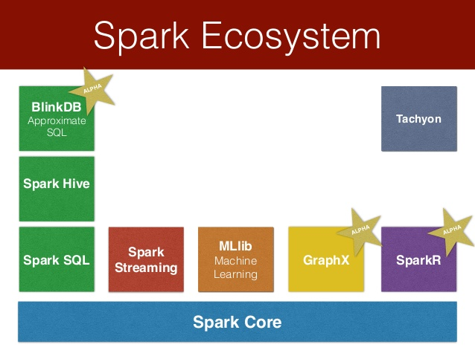

Slide 24
Spark stack
Built on foundation called Spark Core, which provides the necessary functionalities to manage and run distributed applications such as scheduling, coordination, and fault tolerance. It provides a powerful and generic programming abstraction for data processing called resilient distributed datasets (RDDs).
There are a collection of components where each one is designed for a specific data processing workload:
Spark GraphX is for graph processing.
Spark MLlib is for machine learning.
Spark SQL is for batch as well as interactive data processing
Spark Streaming is for real-time stream data processing

Slide 25
Spark - Key Abstractions and Concepts
RDD
Transformations
Actions
DAG (Graph of all the transformations to be performed on the data)

Slide 26
Resilient Distributed Dataset (RDD)
Basic Data structure of Spark
Snapshot of data at any one time
Immutable
Transform one RDD to another RDD
Can roll back to previous RDD in event of failure
Lazy evaluation: Nothing computed until an action requires it
Actions can be applied to RDDs; actions force calculations and return values

Slide 27
Spark in-memory processing
Resilient Distributed Datasets (RDDs) - memory structures which hold the information you want to load into and then process within Spark
Resilient because they keep track of their history (edits and deletions) so they can reconstruct themselves if there are any failures
Distributed - they are dispersed across multiple nodes in the cluster to support parallel processing
Datasets - Group of data on which we are performing different operations
When presented with a request from an application, a Spark solution uses the platform’s internal features to create and then load data into an RDD. Data source can be HDFS, Cloud storage, Apache HBase, RDBMS

Slide 28
Spark RDD
Immutable distributed collection of objects. Each dataset in RDD is divided into logical partitions, which may be computed on different nodes in cluster
Solves the Data sharing issue – in memory.
Data sharing is slow in MapReduce due to replication, serialization and disk IO. Most of the Hadoop MapReduce applications spend approx 90% of the time doing HDFS I/O
Spark RDD supports in memory processing computation as it stores the state of memory as an object across the jobs and this is sharable between those jobs
Data sharing in memory is 10 to 100 times faster than Disk IO

Slide 29
RDD
Each dataset in RDD is divided into partitions and computed on different nodes of the cluster. Due to this transformations/ actions are done in parallel
RDDs are highly resilient; they are able to recover quickly from any issues as the same data chunks are replicated across multiple executor nodes.
When you create an RDD it becomes immutable
Two ways to create RDDs − parallelising an existing collection in your driver program, or by referencing a dataset in an external storage system, such as a shared file system, HDFS, HBase,

Slide 30
RDD Partitions (i)
Partitions are basic units of parallelism in Apache Spark
RDDs in Spark are collection of partitions
Spark automatically partitions RDDs and distributes the partitions across different nodes.
A partition in spark is an atomic chunk of data (logical division of data) stored on a node in the cluster.
RDDs are automatically partitioned in Spark without human intervention.

Slide 31
RDD Partitions (ii)
By default one partition is created for each block of the file in HDFS.
However, when creating a RDD a second argument can be passed that defines the number of partitions to be created for an RDD.
val rdd= sc.textFile (“file.txt”, 5)
The code above will create an RDD with 5 partitions.
The best way to decide on the number of partitions in an RDD is to make the number of partitions equal to the number of cores in the cluster so that all the partitions will process in parallel and the resources will be utilised in an optimal way
If your cluster has 50 cores, there should be 50 partitions

Slide 32
Spark – RDD Persistence
You can persist (cache) an RDD – it will stay in memory and avoid to recompute
When you persist an RDD, each node stores any partitions of it that it computes in memory and reuses them in other actions on that dataset (or datasets derived from it)
Allows future actions to be much faster (often >10x).
Mark RDD to be persisted using the persist() or cache() methods on it. The first time it is computed in an action, it will be kept in memory on the nodes.
Cache is fault-tolerant – if any partition of an RDD is lost, it will automatically be recomputed using the transformations that originally created it
Can choose storage level (MEMORY_ONLY, MEMORY_AND_DISK)
Can manually call unpersist()

Slide 33
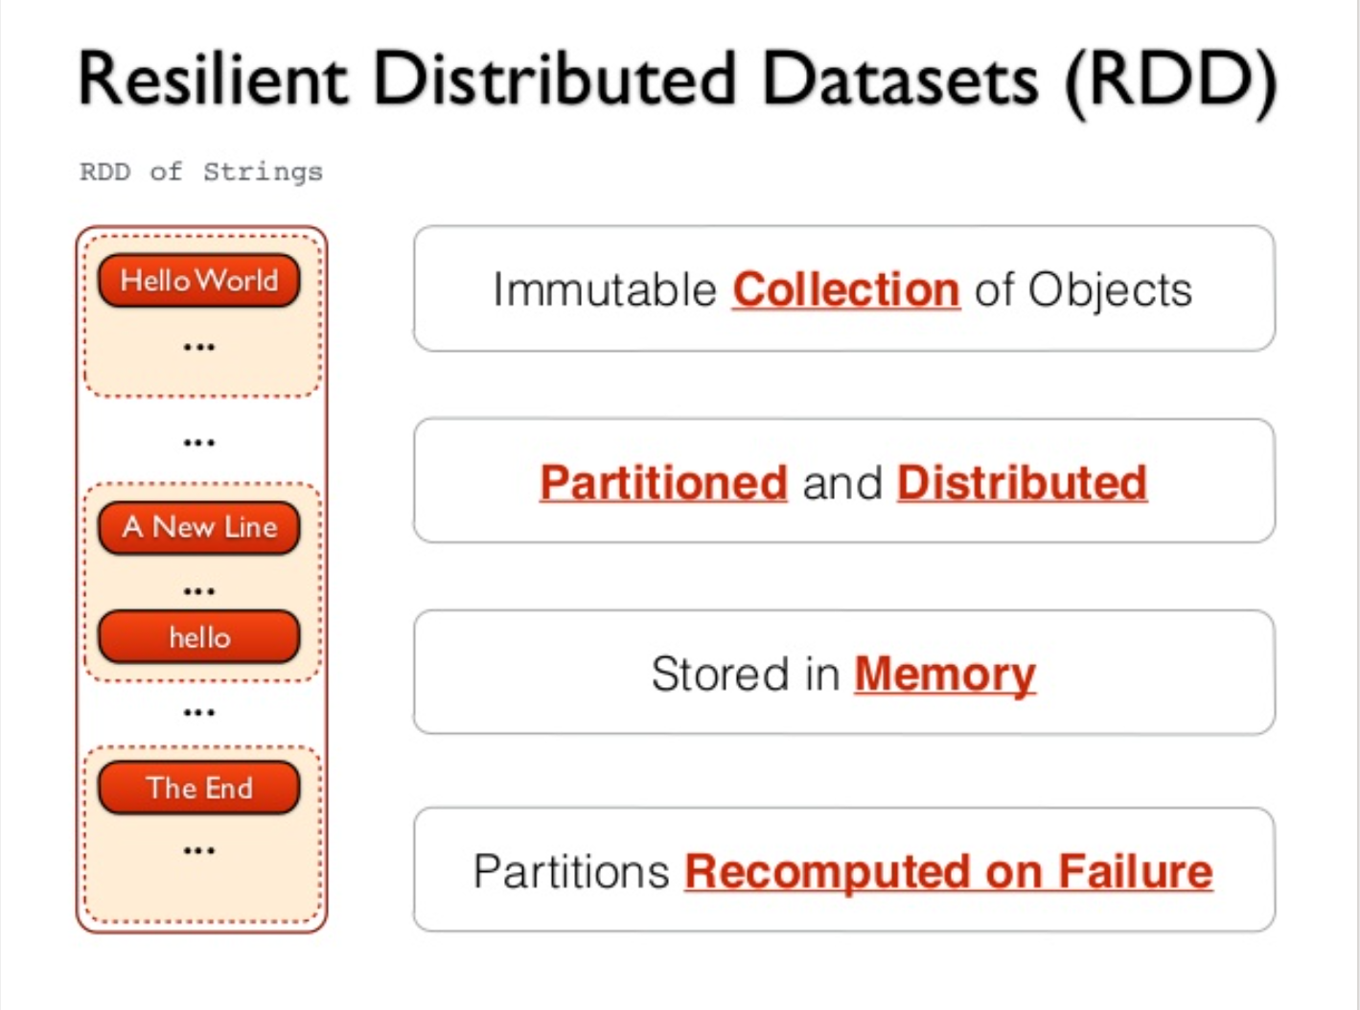
https://www.slideshare.net/frodriguezolivera/apache-spark-streaming

Slide 34
Once the data is in RDD Spark permits two types of operation: transformations and actions (I)
Transformations eg filtering, mapping or manipulating the data, automatically triggers the creation of new RDD.
The original RDD remains unchanged, no matter what happens to subsequent RDDs. This immutability allows Spark to keep track of changes that are carried out during the transformation and make it possible to restore matters back to normal should a failure occur - hence the “resilient” in its name!
Transformations are not executed until the moment they are needed, such as by an action – this is known as lazy evaluation.
this improves performance by delaying computations until the instant it is required, rather than potentially conducting computations that is not required

Slide 35
Once the data is in RDD Spark permits two primary types of operation: transformations and actions (II)
Actions are behaviours that interact with the data but do not change it eg Counting, Retrieving a specific element, Aggregating
when we want to work with the actual dataset in RDD we use Action.
When an Action occurs it does not create the new RDD, unlike transformation.
Operations are broken up into transformations applied to data sets and changes RDD data. Actions to does not change data but produce a result

Slide 36
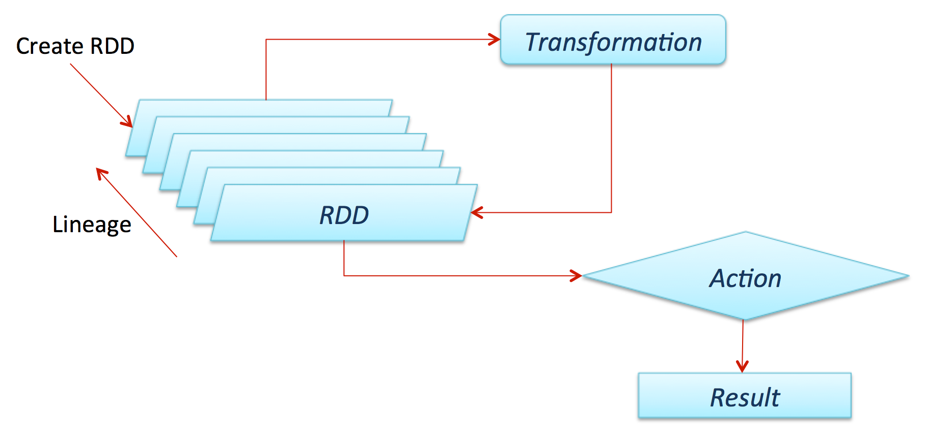
Transformation Process in Spark

Slide 37
Sample Spark transformations
map(func): Return a new distributed dataset formed by passing each element of the source through a function func.
filter(func): Return a new dataset formed by selecting those elements of the source on which func returns true
reduceByKey(func): Returns a new dataset, where the values for each key are aggregated using the given reduce function func
union(otherDataset): Return a new dataset that contains the union of the elements in the source dataset and the argument.
intersection(otherDataset): Return a new RDD that contains the intersection of elements in the source dataset and the argument.
distinct([numTasks])): Return a new dataset that contains the distinct elements of the source dataset

Slide 38
Sample Spark Actions
count(): Return the number of elements in the dataset.
collect(): Return all the elements of the dataset as an array at the driver program. This is usually useful after a filter or other operation that returns a sufficiently small subset of the data.
foreach(func): Run a function func on each element of the dataset.
saveAsTextFile(path): Write the elements of the dataset as a text file (or set of text files) in a given directory in the local filesystem, HDFS or any other supported file system.
Remember: Actions cause calculations to be performed;
transformations just set things up (lazy evaluation)

Slide 39
Lazy Evaluation
Work can magically disappear!
Wife – Can you go and get some soft drink from Tescos for Lunch
Husband – Yes, I’ve made a note and I’ll get it (but carries on doing what he was doing (watching TV!))
A while Later ...
Wife – Actually forget getting the soft drink, lets drink water instead
Husband – Ok
Sometimes being Lazy finish first!
Lazy Evaluation - It waits until you are done giving it operators and only when you ask it to give you the final answer does it evaluate and it always looks to limit how much work it has to do
Lazy evaluation means the execution of transformations is not triggered until an action needs results

Slide 40
Lazy evaluation example
You want to join two RDD like data structure that contain customer data based on a common identifier, but then filter out the records for customers located in London. In a procedural execution environment, the join would be performed first, and the result set would be scanned for those records with an address in London
Analysis show that the no of records from London in each of the sets to be joined is relatively small; it can then switch the order of operations so that those subsets of the RDD are filtered first, and the interim result sets are joined afterward.
This runs faster for two reasons:
the filters are applied to separate RDD and both can be done in parallel
and the resulting sets to be “joined” are much smaller and reduces time to execute
By building execution plan that is not put into effect until a result must be delivered, this can speed Spark performance

Slide 41
Limitation of Spark
RDDs degrade when there is not enough memory to store them – in that case it stores that partition of RDD on disk which does not fit in memory
It will have similar performance to MapReduce
If it is about processing large amounts of big data, Hadoop MapReduce will be cheaper as hard disk space is much cheaper than memory

Slide 42
Spark Shell
Spark Shell is an interactive shell through which we can access Spark API
Is a standalone Spark application written in Scala where you can run ad-hoc queries and get familiar with the features of Spark
Type spark-shell to start

Slide 43
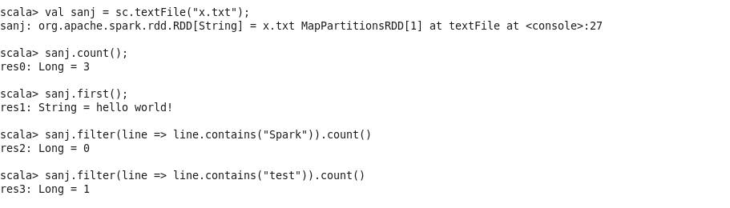
Spark shell example

Slide 44
Tez vs Spark
Both are much faster than MapReduce, but Spark more popular due to being general purpose with API for developers
Tez is framework for purpose built tools like Hive

Slide 45
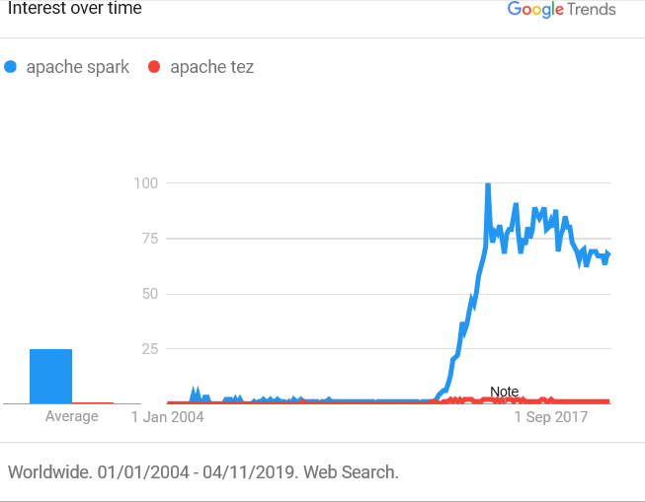

Slide 46
Video
https://www.youtube.com/watch?v=TgiBvKcGL24

Slide 47
Spark Application
Spark Applications consist of driver process and set of executor processes. The driver process runs your main() function, sits on a node in the cluster, and is responsible for 3 things: maintaining information about the Spark Application; responding to a user’s program or input; and analysing, distributing, and scheduling work across the executors
The executors/workers are responsible for executing the work that the driver assigns them. This means, each worker is responsible for only two things: executing code assigned to it by the driver and reporting the state of the computation, on that executor, back to the driver node
The cluster manager controls physical machines and allocates resources to Spark Application. This can be Spark standalone cluster manager, YARN, or Mesos

Slide 48
